Slide 1



ASSIGNMENT-2
Design and Implementation of AES Encryption System
Presented by :
Paras Dhiman(2021482)
Aekansh Kathunia (2021127)

Slide 2

Introduction
Objective: Implement the AES algorithm in Python, demonstrating encryption and decryption functionalities to understand and validate its key components and operations, emphasizing its importance in data security.
Overview:
AES (Advanced Encryption Standard) is a symmetric encryption algorithm widely used for securing sensitive data.
It's essential for ensuring secure data transmission over networks.
Significance:
Developed to replace the aging DES (Data Encryption Standard) algorithm.
Utilizes a block cipher with variable key lengths (128, 192, or 256 bits).

Slide 3
Key Components of AES
Key Expansion: Involves generating round keys from the initial encryption key, ensuring that each round of AES encryption has a unique subkey derived from the original key.
SubBytes: This step substitutes each byte in the state matrix with a corresponding byte from a predefined S-box, introducing non-linearity and confusion in the encryption process.
ShiftRows: Involves cyclically shifting the rows of the state matrix to the left, with each row having a different offset, adding diffusion and enhancing the diffusion properties of AES.
MixColumns: A transformation applied to each column of the state matrix, involving a matrix multiplication operation, providing further diffusion and increasing the complexity of the encryption algorithm.
.AddRoundKey: This step involves performing a bitwise XOR operation between the state matrix and the round key, ensuring each byte of the state matrix is mixed with a unique portion of the key, adding security and making the encryption reversible.

Slide 4

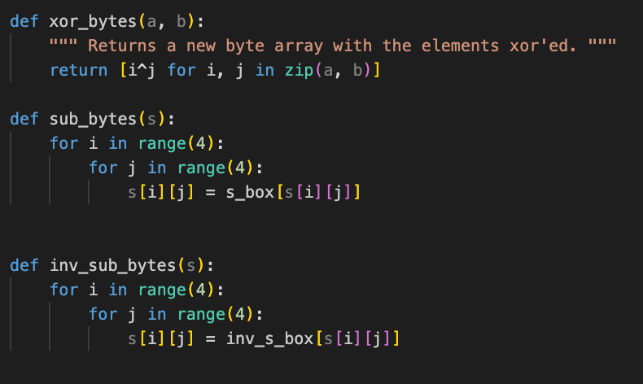
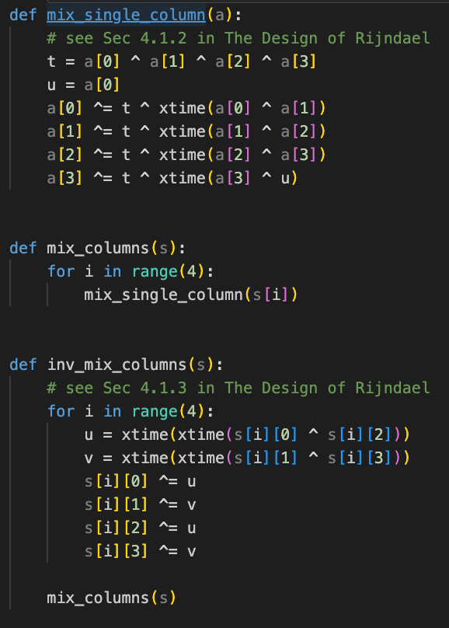
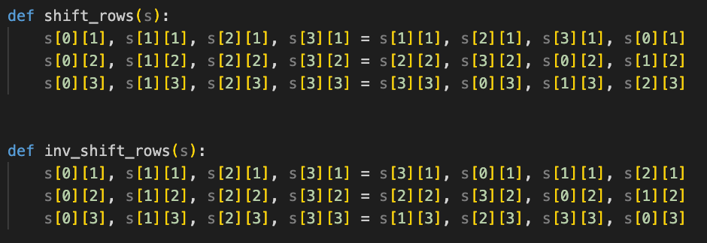
Implementation
Code Snippets:
Programming Language Used:
Python programming language chosen for the implementation.
Python's versatility and ease of use make it suitable for cryptographic tasks.

Slide 5
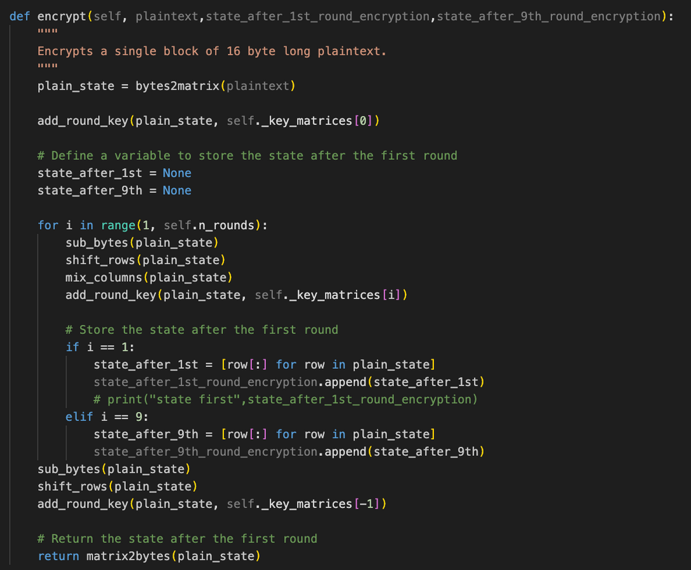
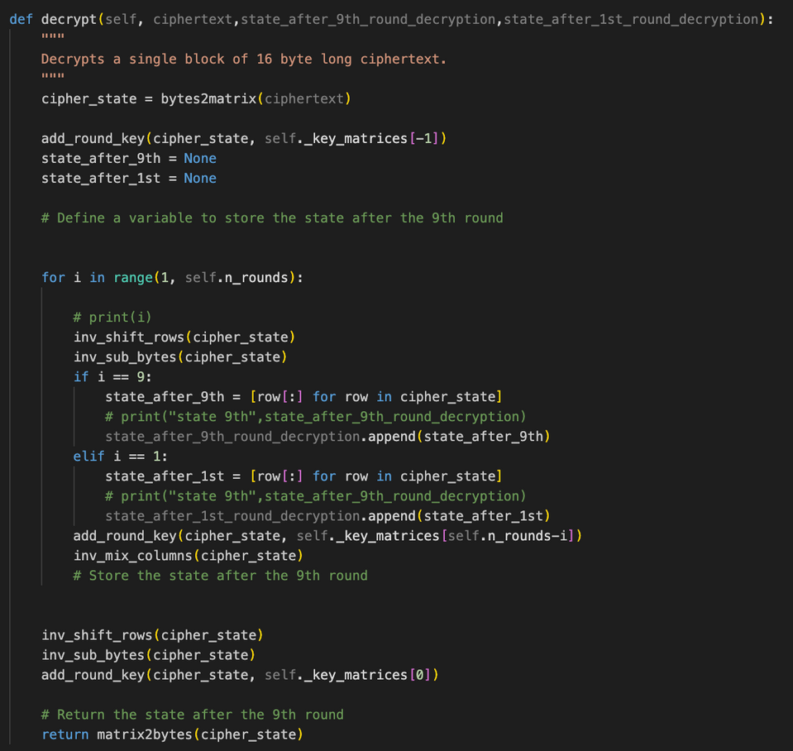
Encryption and Decryption
Code Snippets:

Slide 6
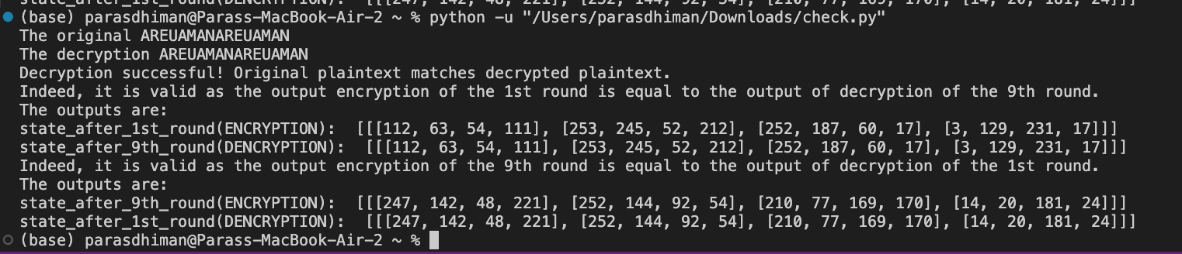
Results
The results exhibit the successful encryption and decryption of the provided plaintext "AREUAMANAREUAMAN." The decrypted output perfectly matches the original plaintext, confirming the accuracy of the decryption process. Moreover, the consistency between the output of encryption's 1st round and decryption's 9th round demonstrates the integrity of the AES implementation. This consistency underscores the algorithm's reliability and its ability to accurately reverse the encryption process, ensuring data integrity and security.

Slide 7
Conclusion
Efficacy of AES Algorithm:
The AES encryption system showcases the effectiveness of the Advanced Encryption Standard (AES) in protecting sensitive data through key processes like expansion, substitution, shifting, mixing, and addition, ensuring robust data security.
Resilience Against Attacks:
AES's systematic encryption and decryption procedures, coupled with its inherent complexity, bolster its resilience against cryptographic attacks, highlighting its suitability for secure data transmission and storage.
Adaptability and Optimization:
AES's adaptability allows for customization and optimization to meet specific performance requirements, with potential enhancements such as parallelization and hardware acceleration promising increased efficiency for high-throughput applications.
Versatile Application:
Integration with existing software systems extends AES's applicability across various domains, ranging from secure communication protocols to data storage mechanisms, making it a cornerstone in modern cryptography for safeguarding sensitive information.

Slide 8
﻿THANK YOU

